Slide 1
3-6 Teaching Time Welcome Little Mateys

Slide 2
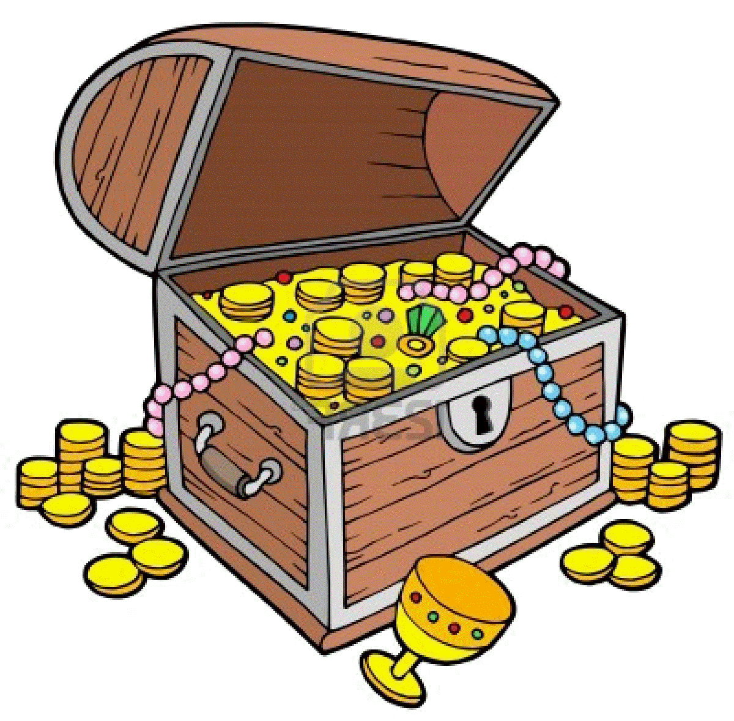
When we are friends with Jesus,
1
2
We are never the same again!
4

Slide 3
When we are friends with Jesus,
1
2
We are never the same again!
He is always with us!
3
4

Slide 4
When we are friends with Jesus,
1
2
We are never the same again!
He is always with us!
3
4
He loves to give us
good
gifts

Slide 5
When we are friends with Jesus,
1
2
We are never the same again!
He is always with us!
3
4
He loves to give us
good
gifts
We have the Greatest Treasure
(to share)

Slide 6
Colossians 2:2-3 God’s mysterious plan is Christ himself. In him lie hidden all the treasures of wisdom and knowledge.

Slide 7
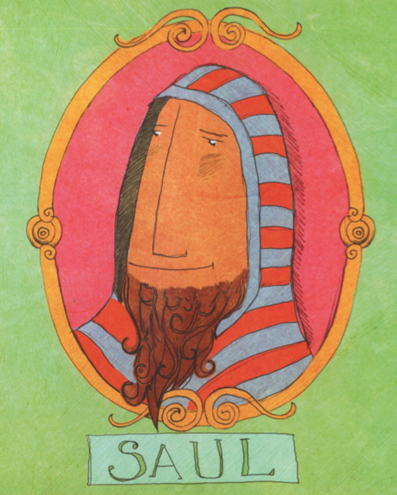
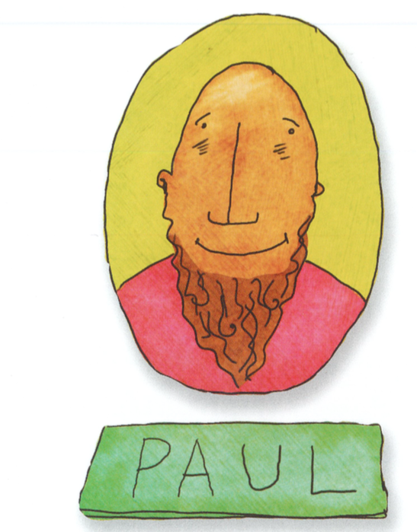
Day 1- New Identity When we are friends with Jesus, we are never the same again!

Slide 8
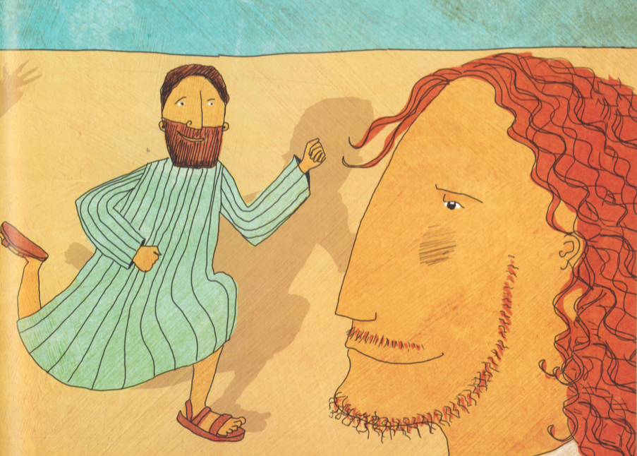
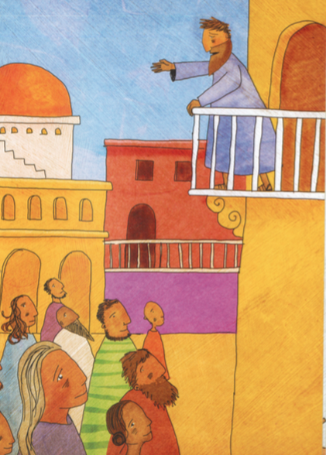
Day 2- Best Friends Forever When we are friends with Jesus, He is always with us.

Slide 9
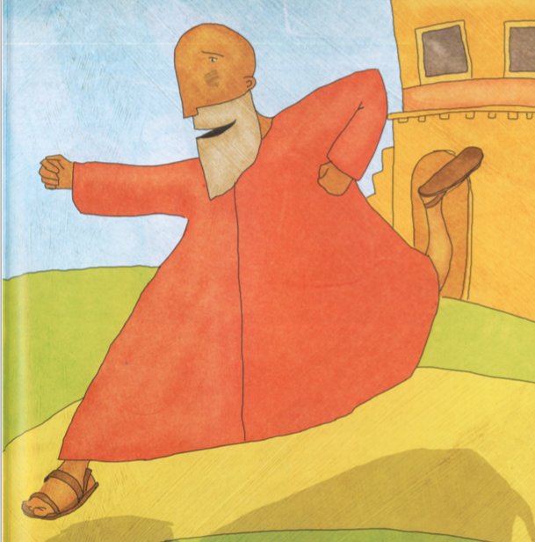
Day 3- Good Gifts When we are friends with Jesus, He loves to give us good gifts!

Slide 10
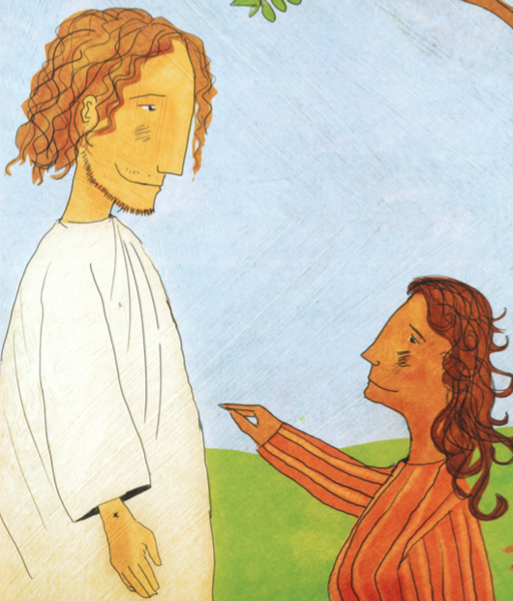
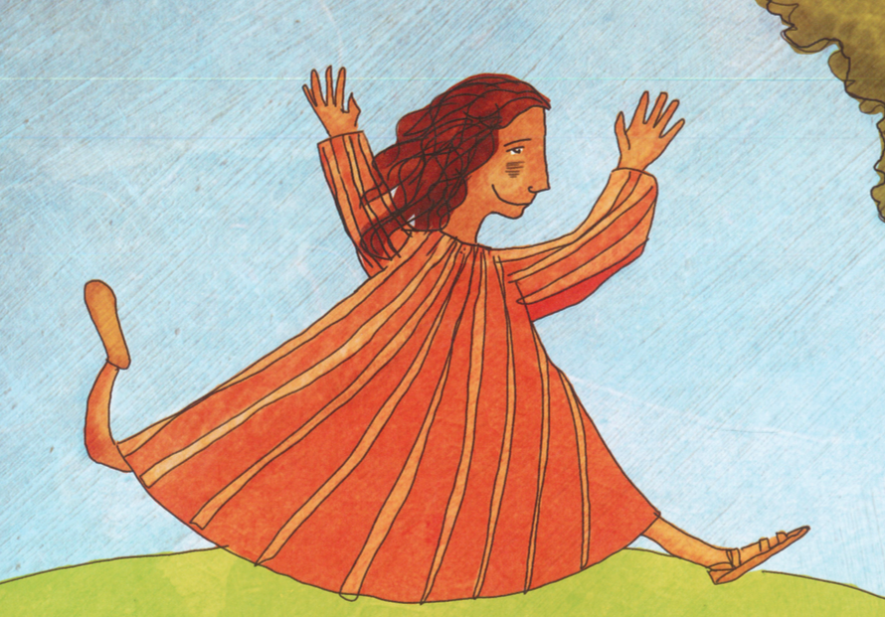
Day 4- Greatest Treasure When we are friends with Jesus, we have the Greatest Treasure!

