Slide 1
ICE AGE 2013

Slide 2
GOD IS ... AGELESS

Slide 3
GUESS A MINUTE

Slide 4
Psalm 90:1-6
God Is Eternal
1 Our Lord, in all generations you have been our home.
2 You have always been God—long before the birth of the mountains, even before you created the earth and the world.
3 At your command we die and turn back to dust,
4 but a thousand years mean nothing to you!
They are merely a day gone by or a few hours in the night.
5 You bring our lives to an end just like a dream.
We are merely tender grass that sprouts and grows in the morning, but dries up by evening.

Slide 5

HOW DO WE MEASURE TIME?
1 … Sun

Slide 6
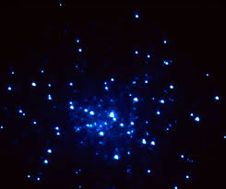
HOW DO WE MEASURE TIME?
2 … stars

Slide 7

HOW DO WE MEASURE TIME? 3 … hour glass

Slide 8
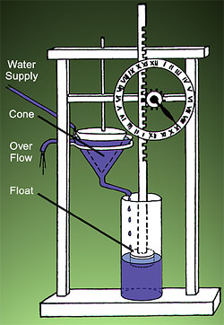
HOW DO WE MEASURE TIME?
4 … Water clocks

Slide 9
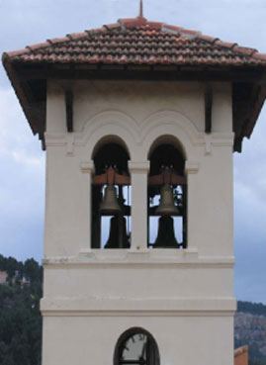
HOW DO WE MEASURE TIME?
5 … Mechanical clocks
French = cloche
Meaning … bell

Slide 10

HOW DO WE MEASURE TIME? 6 … candle clock

Slide 11
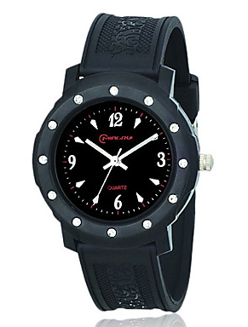
HOW DO WE MEASURE TIME?
7 … wrist watch

Slide 12
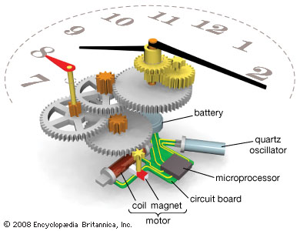
HOW DO WE MEASURE TIME? 8 … quartz clock

Slide 13
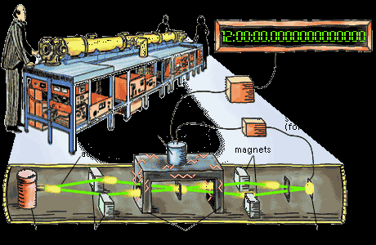
HOW DO WE MEASURE TIME? 9 … Atomic clock

Slide 14
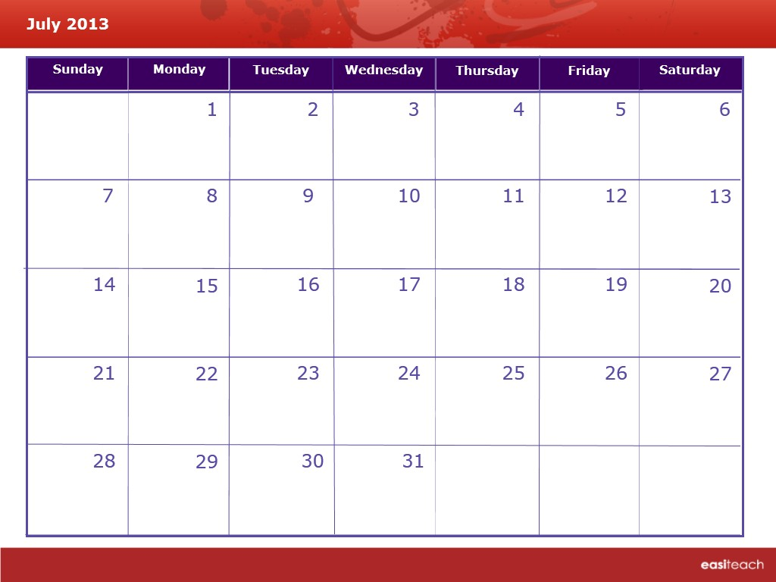
HOW DO WE MEASURE TIME?
10 … calendar

Slide 15
Psalm 90:1-6
God Is Eternal
1 Our Lord, in all generations you have been our home.
2 You have always been God—long before the birth
of the mountains, even before you created the earth and the world.
3 At your command we die and turn back to dust,
4 but a thousand years mean nothing to you!
They are merely a day gone by or a few hours in the night.
5 You bring our lives to an end just like a dream.
We are merely tender grass that sprouts and grows
in the morning, but dries up by evening.

Slide 16
God is great ! ! ! ! ! ! ! ! ! ! !
We are not …

